Slide 1

Introduction to Computer Queue
Professor : Jake Tarn
Lecturer: Sunny

Slide 2
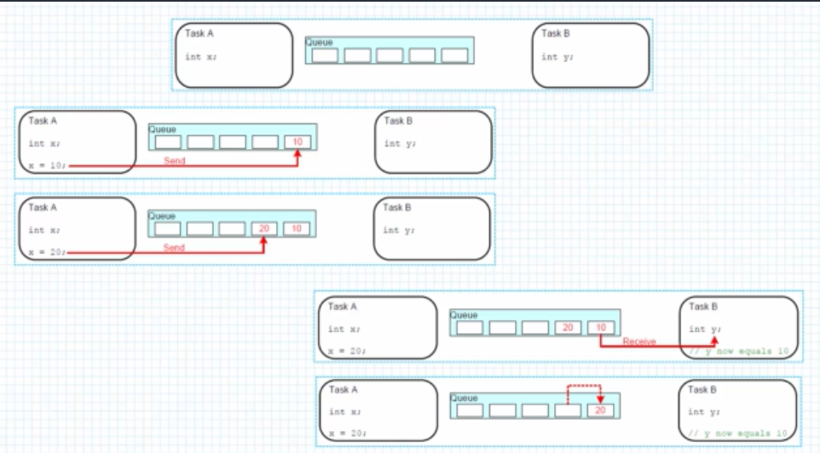
Task communication

Slide 3
Queue Management functions
xQueusCreate()
QueueHandle_t xQueueCreate( UBaseType_t uxQueueLength,
UBaseType_t uxItemSize );
xQueueSend(), xQueueSendToFront(), xQueueSendToBack()
BaseType_t xQueueSend( QueueHandle_t xQueue,
const void * pvItemToQueue,
TickType_t xTickToWait );
Notes:
uxQueueLenght gives the number of elements this queue will be able to handle at any given time.
uxItemSize is the size in byte of any element stored in the queue.
xQueue is the queue to write on. This value is returned by the queue creation method.
pvItemToQueue is a pointer to an element which is wanted to be copied (by value) to the queue.
xticksToWait is the number of ticks to wait before the task gives up to write on this queue.

Slide 4
Queue Management functions
xQueueReceive()
BaseType_t xQueueReceive( QueueHandle_t xQueue,
void * pvBuffer,
TickType_t xTickToWait );
Notes:
xqueue is the identifier of the queue to be read
pvBuffer is a pointer to the buffer where the read value will be copied to. This memory must be allocated and
must be large enough to handle the element read from the queue.
xTicksToWait defines the maximum time to wait.

Slide 5
Simple Queue

Slide 6
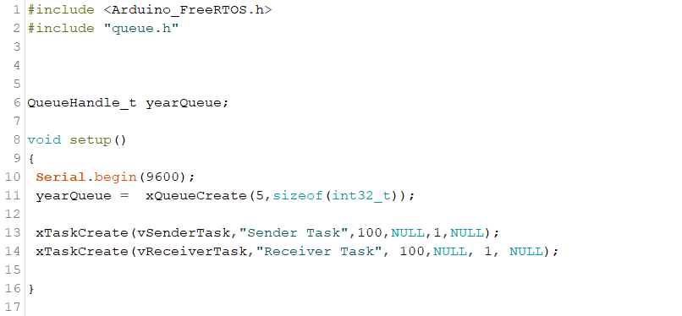

Slide 7
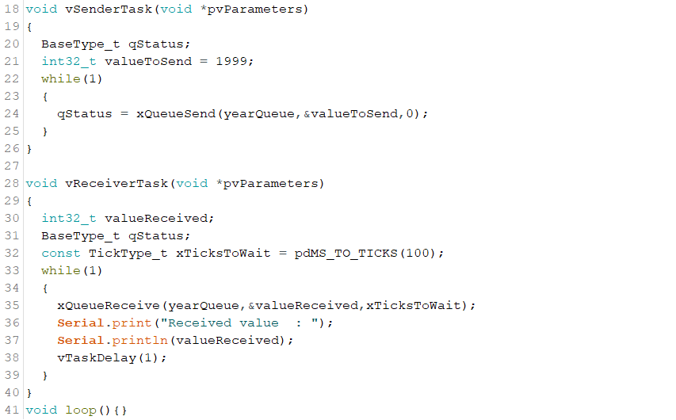

Slide 8
Queue sending from different tasks

Slide 9
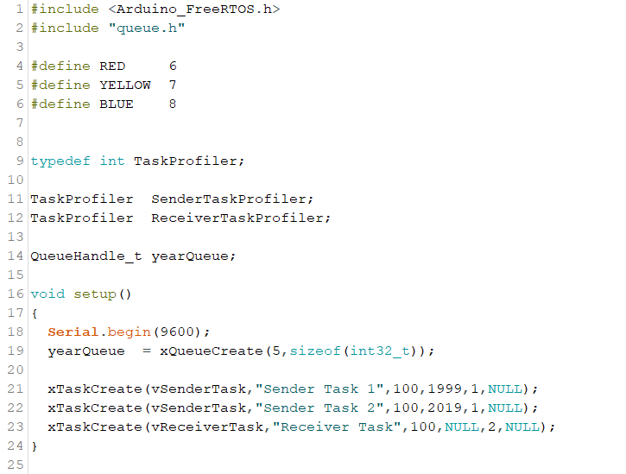

Slide 10
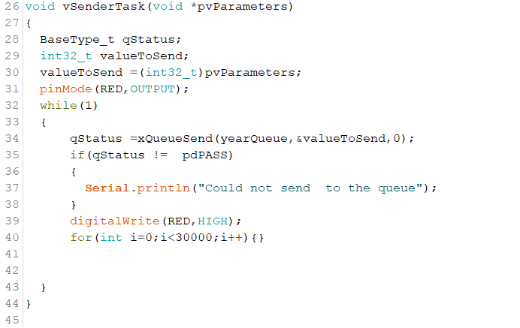

Slide 11
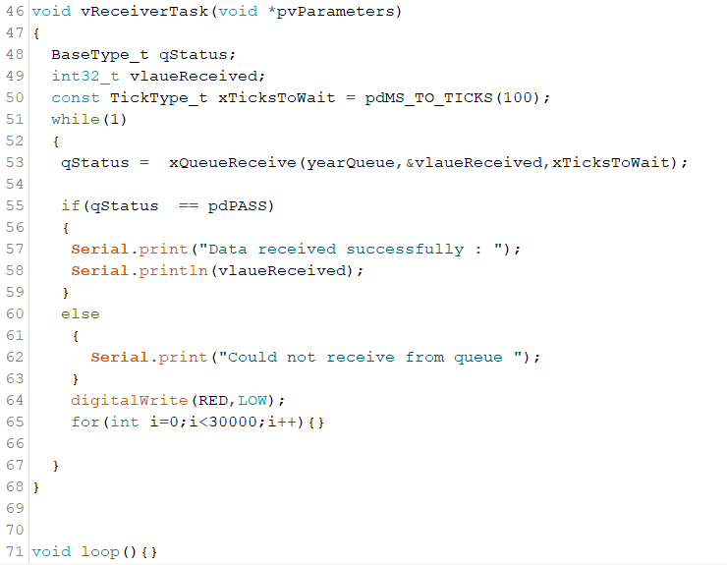

Slide 12
Sending structures onto queues

Slide 13
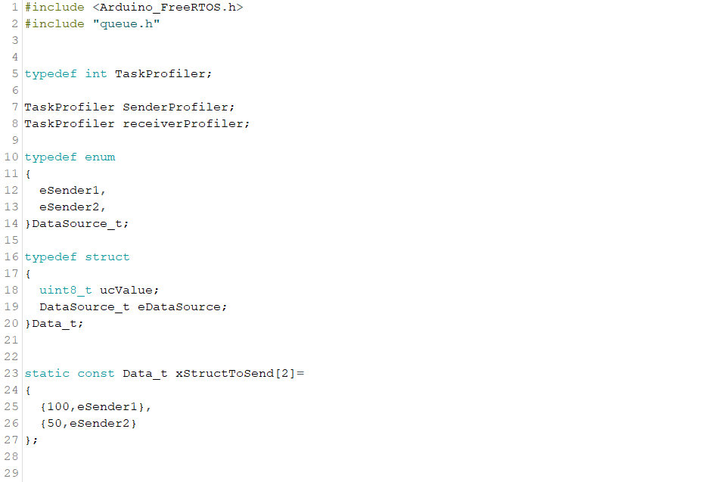

Slide 14
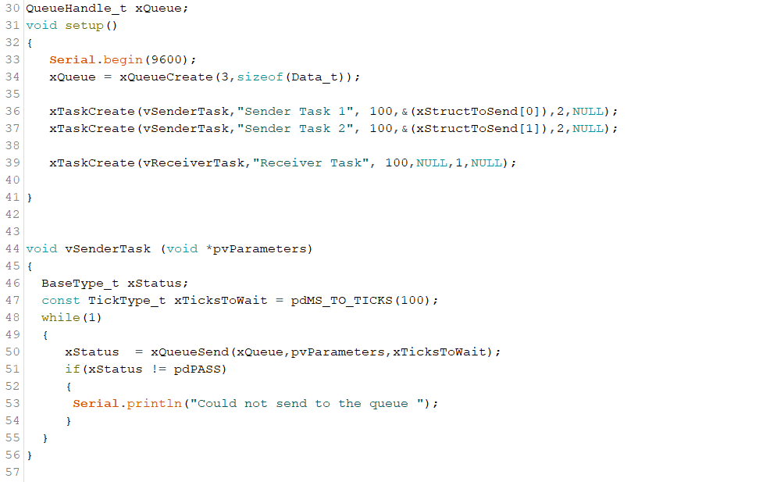

Slide 15
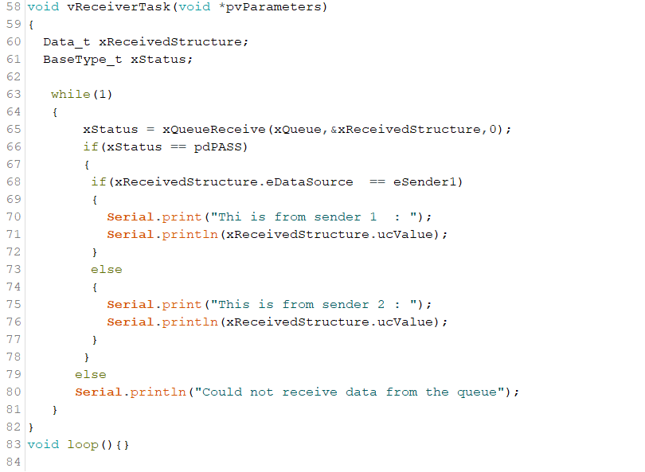

Slide 16
Queue Sets management functions
xQueueCreateSet()
QueueSetHandle_t xQueueCreateSet (
const UBaseType_t uxEventQueueLength
);

Slide 17
Queue Sets management functions
xQueueAddToSet()
BaseType_t xQueueAddToSet(
QueueSetMemberHandle_t xQueueOrSemaphore,
QueueSetHandle_t xQueueSet
);

Slide 18
Queue Sets management functions
xQueueSelectFromSet()
QueueSetMemberHandle_t xQueueSelectFromSet (
QueueSetHandle_t xQueueSet ,
const TickType_t xTicksToWait
);

Slide 19
Queue Sets

Slide 20
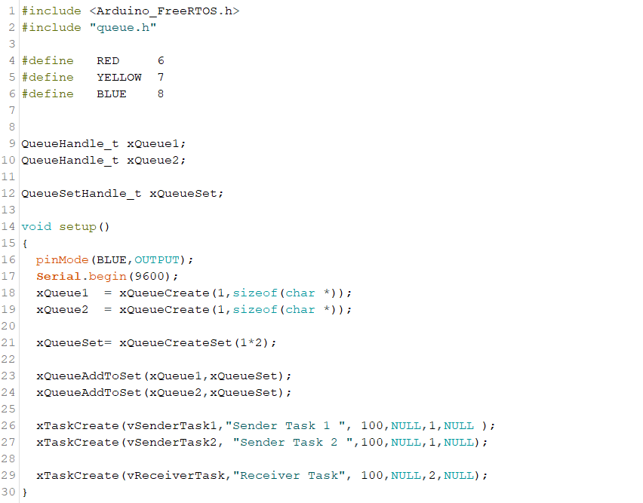

Slide 21
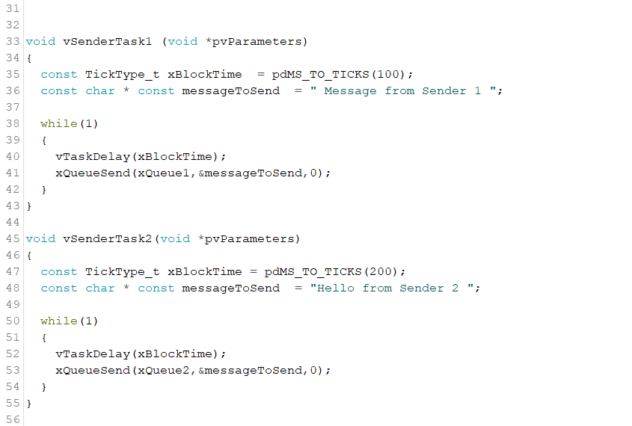

Slide 22
